Slide 1

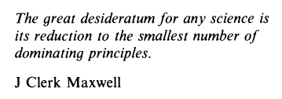
PH101: Introductory Class
(August 8, 2018)
PH103 Trivia
Ajay Thakur
Department of Physics
Indian Institute of Technology Patna
Acknowledgment:
J. N. Shive and R. L. Weber, Similarities in Physics
ISBN-13: 978-0852745403

Slide 2
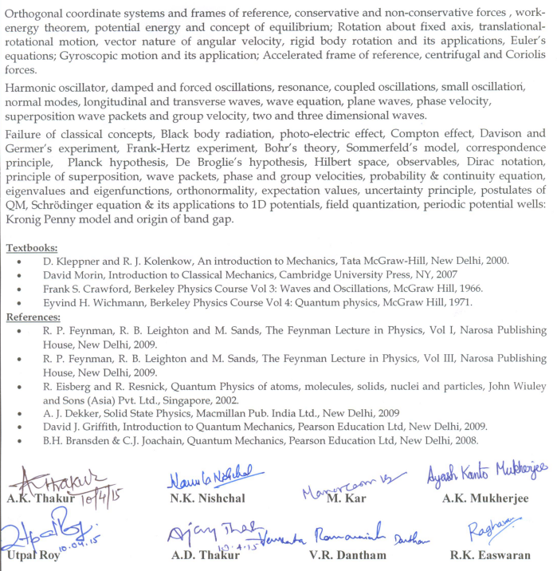
Syllabus for PH103

Slide 3
Syllabus for PH103
3-1-0-8

Slide 4
Evaluation Scheme
Mid-Sem : 30
Quiz : 10
Tutorials/Assignments : 10
End-Sem : 50
Mid-Sem : 30*
Quiz : 10
Tutorials/Assignments : 10
End-Sem : 50*
*Partial credit to additional in-sem work (hands-on/homework/…)

Slide 5
Demo for Galileo’s experiment NASA
https://www.youtube.com/watch?v=QyeF-_QPSbk

Slide 6
Is Physics cumbersome?
NO
What is Physical Intuition?

Slide 7
PH101: Introductory Class
(August 8, 2018)
Formulas in Physics: Intuition and Beyond
Ajay Thakur
Department of Physics
Indian Institute of Technology Patna
Acknowledgment:
J. N. Shive and R. L. Weber, Similarities in Physics
ISBN-13: 978-0852745403

Slide 8
Outline
Motivation “Formulas in Physics: Intuition and beyond”
… “formulations in Physics” through examples
Demonstrations
Take home message/Outlook

Slide 9
Motivation
Physics attempts to understand the relationships between various physical quantities.
As a result, it is crucial in our endeavour to learn about nature.
An understanding of physics so as to apply it to solve unsolved problems requires more than a mere understanding of facts and formulas.
The uncanny ‘ability to connect seemingly unrelated phenomena’ aka ‘intuition’ is an essential component of expertise in physics.

Slide 10
Tools for a Physicist
(valid for all scientists in general)
Observation of Nature
Performance of Experiments
Application of Reasoning
Formulate laws and principles

Slide 11
…few Examples

Slide 12
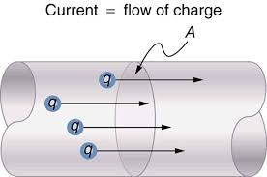

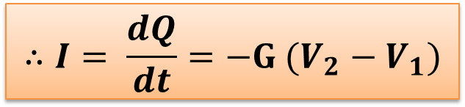
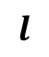
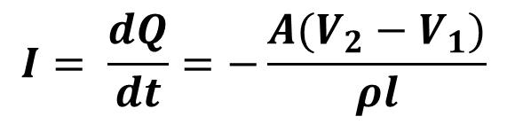
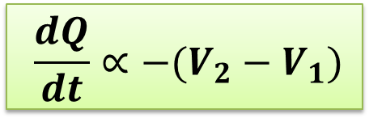
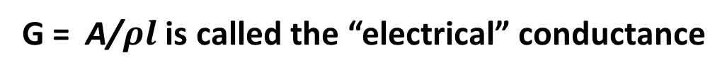
Steady Flow of Electric Charge
$$I$$
$$I= \frac{dQ}{dt}=−\frac{A(V_{2}−V_{1})}{ρl}$$
$$l$$
ρ is electrical resistivity
the minus sign indicates that the flow is directed away from the point of higher positive potential
$$∴I= \frac{dQ}{dt}=−G (V_{2}−V_{1})$$
G = A/$ρl$ is called the “electrical” conductance
$$\frac{dQ}{dt}∝−(V_{2}−V_{1})$$
with G as the constant of proportionality

Slide 13
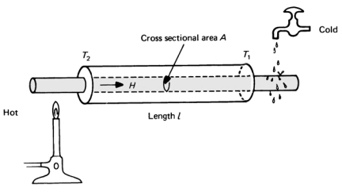
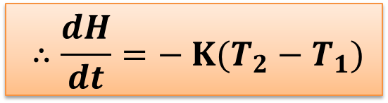
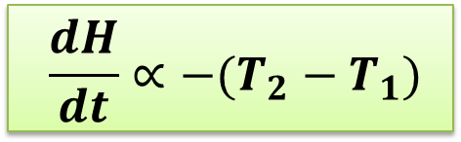
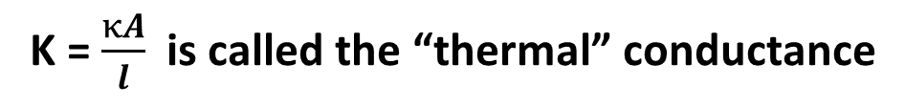
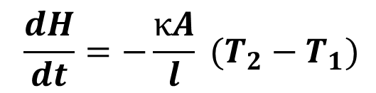
Steady Flow of Heat
$$\frac{dH}{dt}=−\frac{κA}{l} (T_{2}−T_{1})$$
κ Is thermal conductivity
the minus sign indicates that the flow is directed away from the point of higher positive temperature
$$∴\frac{dH}{dt}=− K(T_{2}−T_{1})$$
K = $\frac{κA}{l}$ is called the “thermal” conductance
$$\frac{dH}{dt}∝−(T_{2}−T_{1})$$
with K as the constant of proportionality

Slide 14
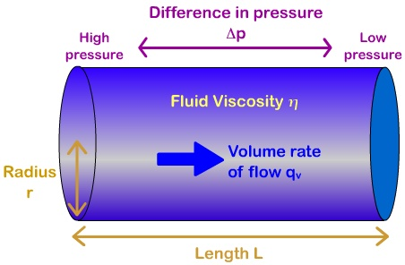
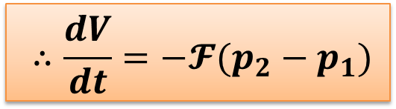

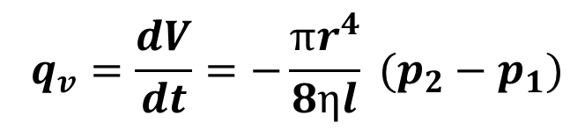
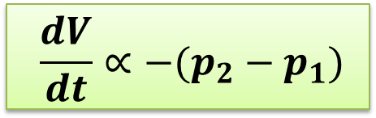
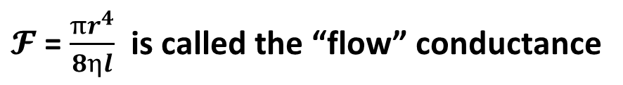
Steady Flow of Fluid
$$q_{v}=\frac{dV}{dt}=−\frac{πr^{4}}{8ηl} (p_{2}−p_{1})$$
the minus sign indicates that the flow is directed away from the point of higher positive pressure
$$∴\frac{dV}{dt}=−𝓕(p_{2}−p_{1})$$
$𝓕$ = $\frac{πr^{4}}{8ηl}$ is called the “flow” conductance
$$\frac{dV}{dt}∝−(p_{2}−p_{1})$$
with $𝓕$ as the constant of proportionality

Slide 15
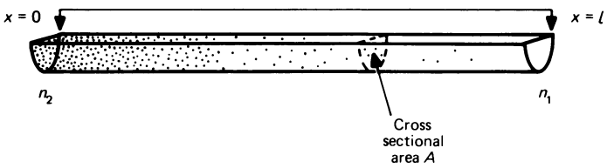
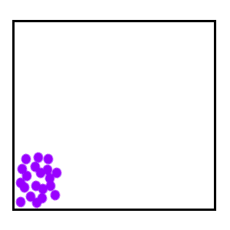
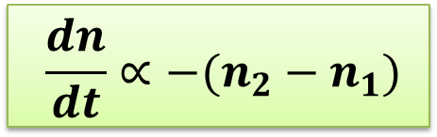
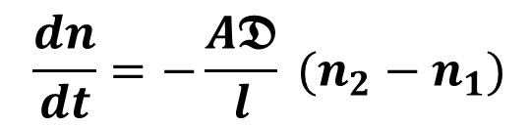
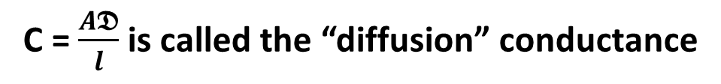

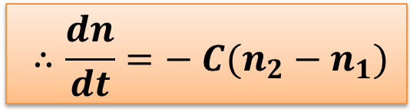
Diffusion
$𝕯$ is diffusion constant
$$\frac{dn}{dt}=−\frac{A𝕯}{l} (n_{2}−n_{1})$$
the minus sign indicates that the flow is directed away from the point of higher positive concentration
$$∴\frac{dn}{dt}=− C(n_{2}−n_{1})$$
C = $\frac{A𝕯}{l}$is called the “diffusion” conductance
$$\frac{dn}{dt}∝−(n_{2}−n_{1})$$
with C as the constant of proportionality

Slide 16
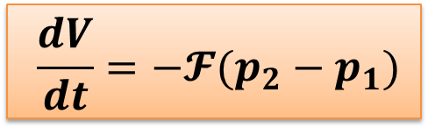
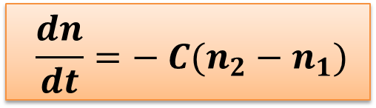
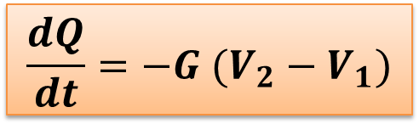
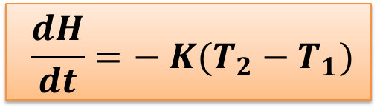
Steady Flow
$$\frac{dQ}{dt}=−G (V_{2}−V_{1})$$
Electricity
Ohm’s law
$$\frac{dH}{dt}=− K(T_{2}−T_{1})$$
Heat
Fourier’s law
$$\frac{dV}{dt}=−𝓕(p_{2}−p_{1})$$
Hagen-Poiseuille law
Fluid
$$\frac{dn}{dt}=− C(n_{2}−n_{1})$$
Brownian Diffusion
Diffusion
Does this point to an underlying generality of the phenomenon of flowing?

Slide 17
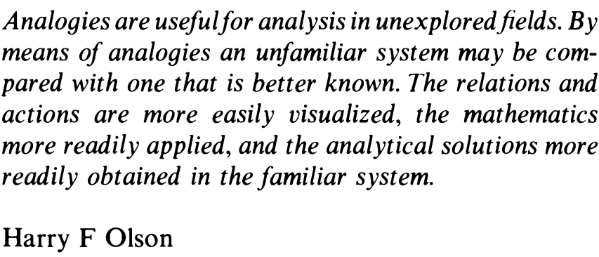
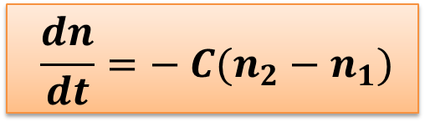
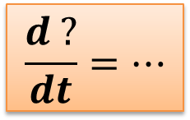
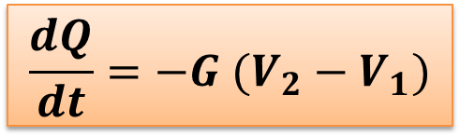
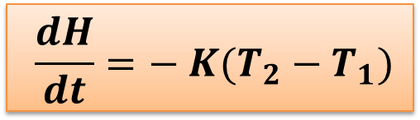
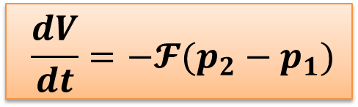
Steady Flow
$$\frac{dQ}{dt}=−G (V_{2}−V_{1})$$
Something which flows
Cause of flow
$$\frac{dH}{dt}=− K(T_{2}−T_{1})$$
$$\frac{dV}{dt}=−𝓕(p_{2}−p_{1})$$
$$\frac{d ?}{dt}=…$$
$$\frac{dn}{dt}=− C(n_{2}−n_{1})$$
Intuition demystified!

Slide 18

What did we see just now?
Steady Flow
Source
Sink
The process approaches an end point, asymptotically

Slide 19
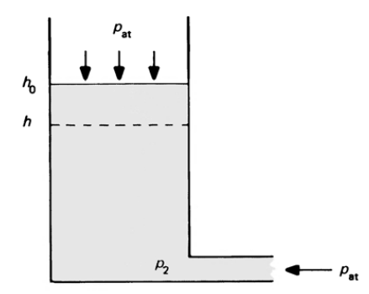
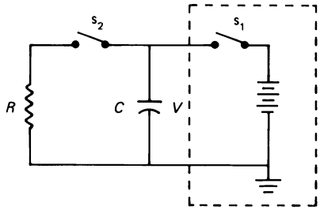
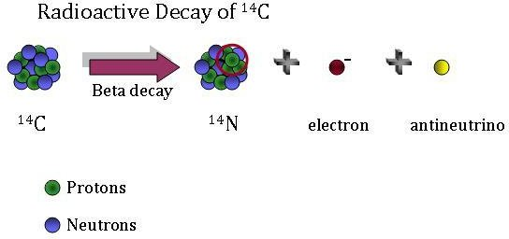
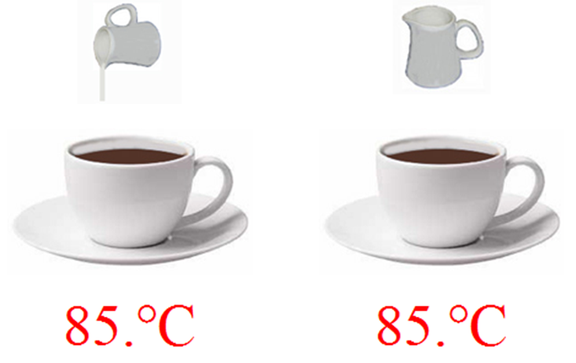
Processes where rate becomes less and less over time
Emptying of a Water Tank
Discharging of a Capacitor
Radioactive Decay
Cooling of a warm object

Slide 20
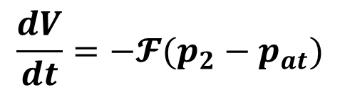
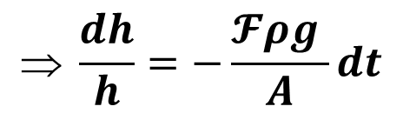
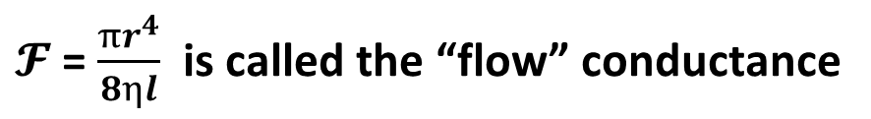
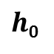
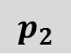
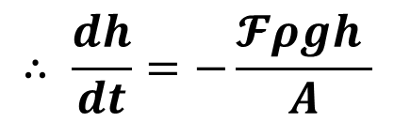
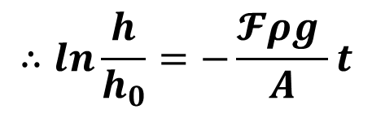
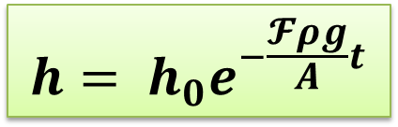
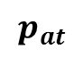
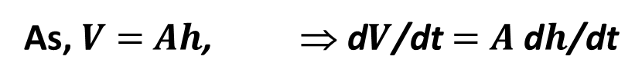
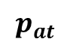
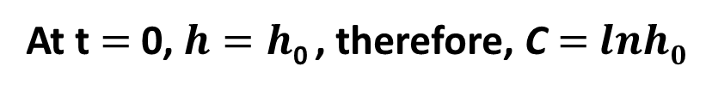




Emptying of a Water Tank
$$p_{at}$$
$$\frac{dV}{dt}=−𝓕(p_{2}−p_{at})$$
$h$₀
$${But, p}_{2}=p_{at}+ρgh$$
$h$
As, $V$ $=$ $Ah$, ⇒ d$V$/dt $=$ $A$ d$h$/dt
$$∴\frac{dV}{dt}=A\frac{dh}{dt}=−𝓕ρgh$$
$$p_{2}$$
$$p_{at}$$
$$∴ \frac{dh}{dt}=−\frac{𝓕ρgh }{A}$$
$$ \frac{dh}{h}=−\frac{𝓕ρg }{A}dt$$
$$Integrating, lnh=−\frac{𝓕ρg }{A}t+C$$
$$∴ln\frac{h}{h_{0}}=−\frac{𝓕ρg }{A}t$$
At t $=$0, $h=h$₀ , therefore, C $=$ $lnh0$
$$h= h_{0}e^{−\frac{𝓕ρg}{A}t}$$
Finally,
$𝓕$ = $\frac{πr^{4}}{8ηl}$ is called the “flow” conductance

Slide 21








Emptying of a Water Tank
$$p_{at}$$
$$h= h_{0}e^{−\frac{𝓕ρg}{A}t}$$
$h$₀
$h$₀
$h$
Water level, $h$
$$p_{2}$$
$$p_{at}$$
Time, $t$
Exponential Decay
τ : relaxation time
As t $→$∞, $h→0$
Observations
At t = A/$𝓕ρ$g = τ, $h=\frac{1}{e}h$₀
At t = $n$τ, $h={(\frac{1}{e})}^{n} h$₀

Slide 22






Processes where rate becomes less and less over time
Emptying of a Water Tank
Discharging of a Capacitor
$$∴ \frac{dh}{dt}=−\frac{𝓕ρgh }{A}$$
$$\frac{dQ}{dt}=−\frac{1}{RC}Q$$
$𝓕$ = $\frac{πr^{4}}{8ηl}$ is “flow” conductance
τ = RC discharge time constant
Radioactive Decay
Cooling of a warm object
$$∴ \frac{dN}{dt}=−λN$$
$$\frac{dT}{dt}=−Ξ(T−T_{a})$$
$Ξ$depends on size, shape, specific heat, surface condition of an object, etc.
λ is decay rate
t_{1/2} = λ

Slide 23

Processes where rate becomes less and less over time
Emptying of a Water Tank
Discharging of a Capacitor
$$∴ \frac{dh}{dt}=−\frac{𝓕ρgh }{A}$$
$$\frac{d?}{dt}∝− \frac{1}{τ}(?−?_{0})$$
$$\frac{dQ}{dt}=−\frac{1}{RC}Q$$
$𝓕$ = $\frac{πr^{4}}{8ηl}$ is “flow” conductance
τ = RC discharge time constant
Radioactive Decay
Cooling of a warm object
$$∴ \frac{dN}{dt}=−λN$$
$$\frac{dT}{dt}=−Ξ(T−T_{a})$$
$Ξ$depends on size, shape, specific heat, surface condition of an object, etc.
λ is decay rate
t_{1/2} = λ

Slide 24

What happens when it is a + sign?
$$\frac{d?}{dt}∝+ \frac{1}{τ}(?−?_{0})$$
$$\frac{d?}{dt}∝− \frac{1}{τ}(?−?_{0})$$
… we will discuss this (and more) some other day?

Slide 25
Outlook
Understanding Physics require keen observations, performance of experiments, application of reasoning, formulation of laws and principles.
There are remarkable similarities between phenomena in different domains.
As a Physicist, pertinent duty is to capture these.
Intuition in Physics/Science.

Slide 26
Strategies for “Problem Solving”
Diagrams
Has the potential to change ‘hopelessly complicated problem’
into a ‘near-trivial one’
Unknown and the known Quantities
E.g., 4 unknowns and only 2 physical facts => Two missing facts
Solve symbolically
Quicker
Less prone to mistakes/easy to detect mistakes
Solves problem ones and for all
Physically appealing (dependence on unknown quantities clear)
Special cases can be easily verified
Programmable
…
Consider Units and Dimensional Validity
Check order of magnitude of numerical answer
“Fermi Problem”: ~ 10^{x}
Plot

Slide 27

Example
Oscillation of a liquid drop
Vibration frequency ν
Density, ρ of liquid
Surface Tension, S
Radius, R
Dimensional Analysis!
ν = K ρªS^{b}R^{c}
$$ν=K\sqrt{\frac{S}{ρR^{3}}}$$
Work harder!

Slide 28

Oscillation of a liquid drop
Mercury drop vibrating in the range 10-120Hz
Source: https://www.youtube.com/watch?v=WR7SIeD-8-o

Slide 29

Intuition Evolves
Question: Flame (Fire) in space?
Source: https://www.youtube.com/watch?v=BxxqCLxxY3M

Slide 30
Intuition Evolves
PH103

Slide 31

Thank you

